Slide 1
Propositional Logic
Gayan Perera,
Pabasara Athukorala

Slide 2
Outline
What is a Proposition
Logical Operations
Truth Tables
Examples using Truth Tables
Tautology
Contradiction
Contingent Proposition
Tautology/Contradiction Examples

Slide 3
Propositions
A proposition is a statement which is either true or false but not both.
Examples:
p: Colombo is in Sri Lanka
q: 17 is a prime number
r: x=3 is a solution of x²=4
Propositions p, q are true and r is false.
Are the following statements propositions?
What is your age?
Do your studies well
x + 2 = 2x

Slide 4
Composite Propositions
Some propositions are composite, that is they are composed of sub statements
e.g. 17 is a prime number and 10 is an even number
A fundamental property of a composite statement is that its truth value is completely determined by the truth value of each of its sub-statements and the way they are connected to form the composite statement.

Slide 5
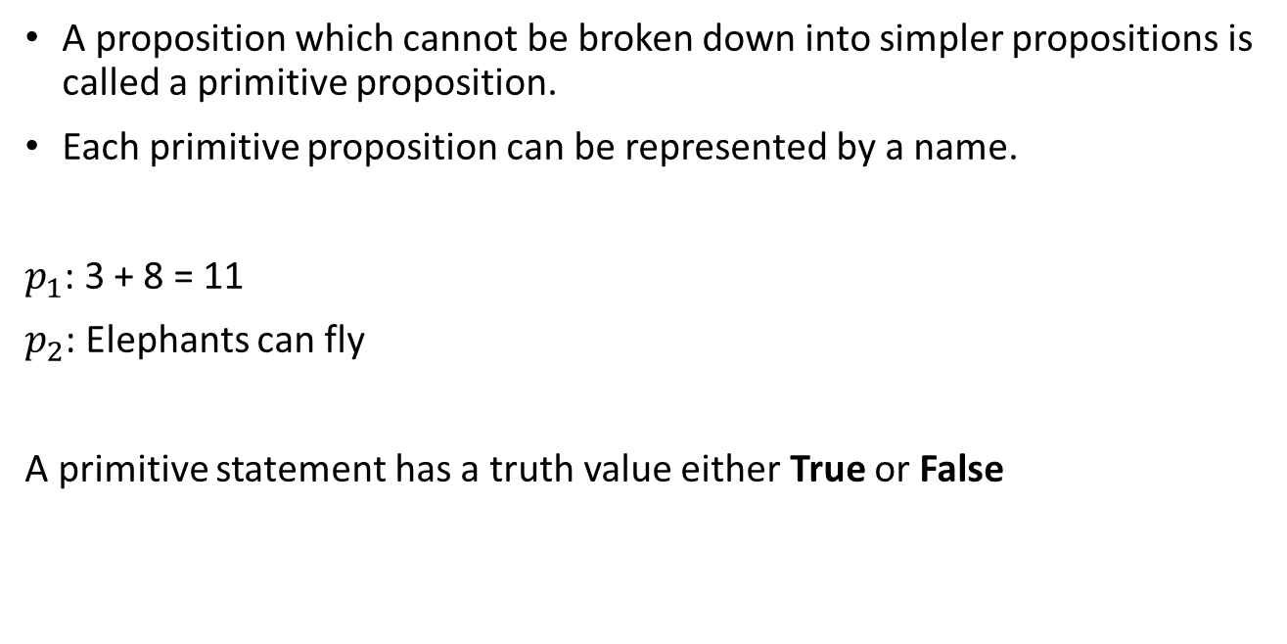
Primitive Propositions
A proposition which cannot be broken down into simpler propositions is called a primitive proposition.
Each primitive proposition can be represented by a name.
$p_{1}$: 3 + 8 = 11
$p_{2}$: Elephants can fly
A primitive statement has a truth value either True or False

Slide 6
Truth Table
A truth table is a computational device by which we can determine the truth value of a proposition once we know the truth value of each of its components.
We can combine primitive propositions using the basic logical operations.

Slide 7
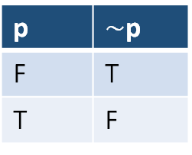

Negation
When any proposition is given, another proposition called Negation of p can be formed by inserting the word “not” before p. Negation of p is denoted by $\sim$p or “not p” or ¬p.
T denotes true and F denotes false. Another way is to replace T with 1 and F with 0.
p | $\sim$p
F | T
T | F

Slide 8
Conjunction
Any two given propositions can be combined with the word “and” to form a compound proposition called the conjunction of the two given propositions.
If p and q are propositions then, p ∧ q (read as “p and q”) denotes the conjunction of the propositions p, q.

Slide 9
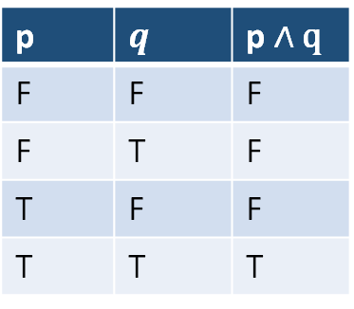
Conjunction
Consider the two propositions p, q. If p is true and q is true, then p ∧ q is true. Otherwise, p ∧ q is false.
p | $$q$$ | p $∧$ q
F | F | F
F | T | F
T | F | F
T | T | T

Slide 10
Disjunction
Any two given propositions can be combined with the word “or” to form a compound proposition called the disjunction of the two given propositions.
If p and q are propositions then, p ∨ q (read as “p or q”) denotes the disjunction of the propositions p, q.

Slide 11
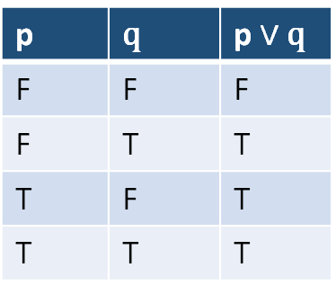
Disjunction
Consider the two propositions p, q. If p is true or q is true then p ∨ q is true. Otherwise p ∨ q is false.
T denotes true and F denotes false. Another way is to replace T with 1 and F with 0.
p | q | p $∨$ q
F | F | F
F | T | T
T | F | T
T | T | T

Slide 12
Construct the following truth tables
Construct the truth table of
(~p) ∧ q
(~p) ∨ (~ q)
~( p ∧ ~q )
Verify the following:
~ (p ∧ q)= (~p) ∨ (~ q)
~ (p ∨ q)= (~ p) ∧ (~ q)
~ ( (p ∨ q) ∧ r ) = (~ p ∧ ~ q) ∨ ~ r

Slide 13
Construct the following truth tables
3. Prove using tables that
p ∧ (q ∧ r) =( p ∧ q) ∧ r
p ∧ (q ∨ r) = (p ∧ q) ∨ (p ∧ r)

Slide 14
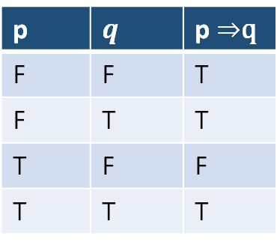

Implication
An implication is of the form “if p is true, then q follows” or take the more shorter form “if p, then q”
An implication is denoted by p $⇒$ q
If p is false it doesn’t matter what will be the truth value of q,
p $⇒$ q is always TRUE
p | $$q$$ | p $⇒$q
F | F | T
F | T | T
T | F | F
T | T | T

Slide 15
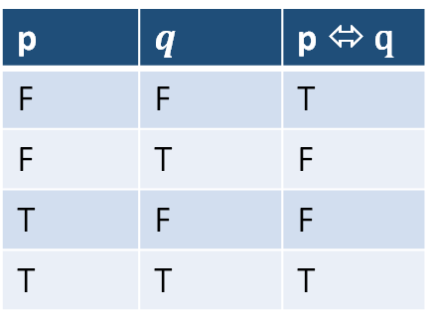
Equivalence
An equivalence p ⬄ q is true if and only if p and q have the same truth value. An equivalence is denoted by ⬄
p | $$q$$ | p ⬄ q
F | F | T
F | T | F
T | F | F
T | T | T

Slide 16
Construct the following truth tables
Construct the truth table of
(p => q) ∧ (q => p)
p<=>q
Construct the truth tables of :
~(p => ~ q)
~ (p ∧ q) ∨ ~(q <=> p)

Slide 17
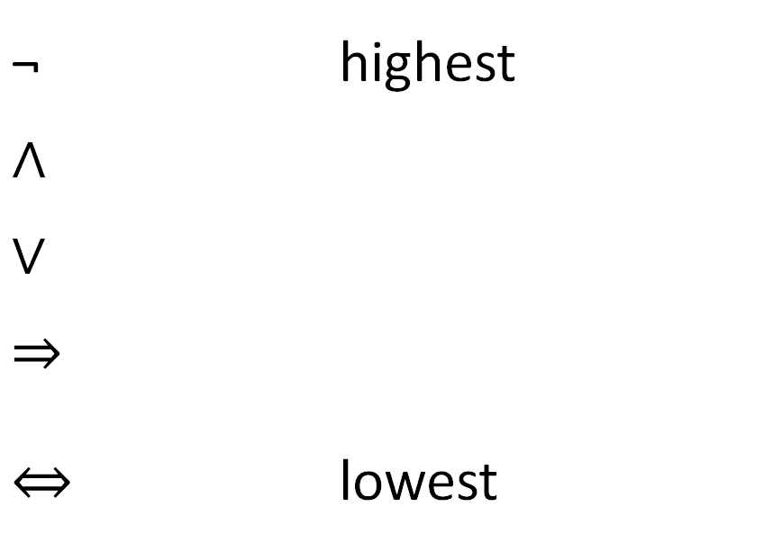
Precedence rules
Propositional logic uses precedence rules
¬ | highest
∧
∨
$$⇒$$
$$⇔$$ | lowest
Brackets override
B,N,C,D,I,E

Slide 18
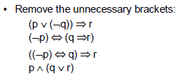
Precedence rules

Slide 19
Exclusive OR
Let p and q be two propositions. The exclusive OR of p and q (denoted by p ⊕ q) is a proposition that simply means exactly one of p and q will be true but both cannot be true
Example :
When you buy a car from XYZ company, you get either Rs. 50000 cashback or accessories worth Rs. 50000
Notes:
A Valid proposition

Slide 20
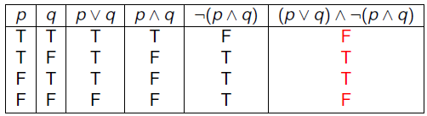

Exclusive OR
Construct the Truth Table for the (p $∨$q) ∧ ~(p ∧ q)
Notes:
A Valid proposition

Slide 21
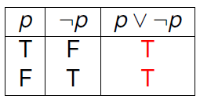
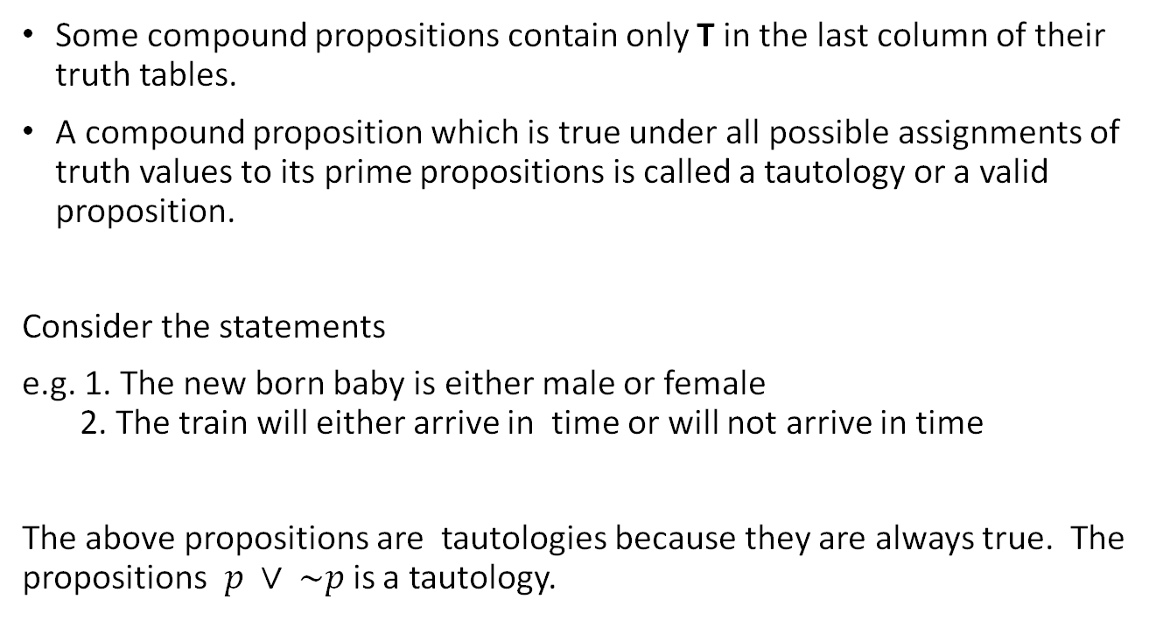
Tautology
Some compound propositions contain only T in the last column of their truth tables.
A compound proposition which is true under all possible assignments of truth values to its prime propositions is called a tautology or a valid proposition.
Consider the statements
e.g. 1. The new born baby is either male or female
2. The train will either arrive in time or will not arrive in time
The above propositions are tautologies because they are always true. The propositions $p ∨ \sim p$is a tautology.
Notes:
A Valid proposition

Slide 22
Tautology
Q. Show that [ (p=>q) ∧ (q=>r) ] => (p=>r) is a tautology.

Slide 23
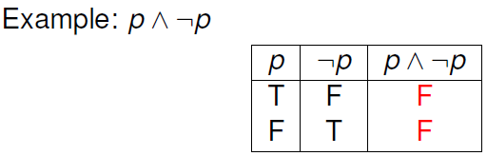
Contradiction
Similarly, some compound propositions contain only F in the last column of their truth tables.
A compound proposition which is false under all possible assignments of truth values to its prime propositions is called a contradiction or an inconsistent proposition.

Slide 24
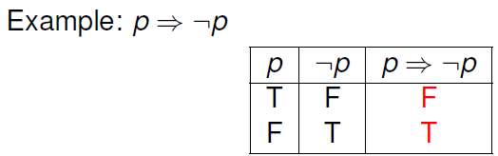
Contingent Proposition
A compound proposition which is neither a tautology nor a contradiction is called a contingent proposition.

Slide 25

Laws in Propositional Logic
Commutative laws
$p \text{∧} \text{q}\text{ = }\text{q}\text{ ∧ }\text{p}$
$p \text{∨} \text{q}\text{ = }\text{q} \text{∨} \text{p}$
Associative Laws
$p \text{∧ }\text{(}\text{q} \text{∧} \text{r}\text{) = (}p \text{∧} \text{q}\text{)}\text{ ∧ }\text{r}$
$p \text{∨} \text{(}\text{q} \text{∨} \text{r}\text{) = (}p \text{∨} \text{q}\text{) ∨ }\text{r}$
3. Distributive Laws
$p \text{∨} \text{(}\text{q}\text{ ∧ }\text{r}\text{) = (}p \text{∨} \text{q}\text{) ∧ (}p \text{∨ }\text{r}\text{)}$
$p \text{∧} \text{(}\text{q} \text{∨ }\text{r}\text{) = (}p \text{∧} \text{q}\text{) ∨ (}p \text{∧} \text{r}\text{)}$

Slide 26

Laws in Propositional Logic
4. De Morgan’s Laws
$\sim (p \text{∧} \text{q}\text{) = \sim }\text{p}\text{ ∨ \sim }\text{q}$
$\sim (p \text{∨} \text{q}\text{) = \sim }\text{p} \text{∧} \text{\sim }\text{q}$
5. Law of Negation
$\sim (\sim p) \text{=} \text{p}$
6. Law of Excluded Middle
$p \text{∨}\text{ \sim }\text{p}\text{ =} \text{true}$
Law of Contradiction
$p \text{∧} \text{\sim }\text{p}\text{ = }\text{false}$

Slide 27

Laws in Propositional Logic
8. Law of Implication
$p⇒q=\text{\sim }\text{p}\text{ ∨ }\text{q}$
9. Contrapositive Law
$\text{p}⇒q=(\sim q⇒\sim p)$
10. Law of Equivalence
$p<=>\text{q}\text{ = (}\text{p}⇒q)\text{∧}(q⇒p)$
11. Idempotence
$p \text{∨} \text{p}\text{ =} \text{p}$
$p \text{∧} \text{p}\text{ = }\text{p}$

Slide 28

Laws in Propositional Logic
12. Laws of Simplification-1
$p \text{∧} \text{true}\text{ = }\text{p}$
$p \text{∨} \text{true}\text{ = }\text{true}$
$p \text{∧ }\text{false}\text{ = }\text{false}$
$p \text{∨} \text{false}\text{ = }\text{p}$
13. Laws of Simplification-2
$p \text{∨}\text{ (}\text{p}\text{ ∧} q)=p$
$p \text{∧} \text{(}\text{p} \text{∨} q)=p$

Slide 29

Laws in Propositional Logic
14. Distributive Laws
$a \text{∨ (}\text{b}\text{ ∧ }\text{c}\text{ ∧ }\text{d}\text{) = (}a \text{∨ }\text{b}\text{) ∧ (}a \text{∨ }\text{c}\text{)} \text{∧ (}a \text{∨ }\text{d}\text{)}$
$a \text{∧} \text{(}\text{b} \text{∨} \text{c} \text{∨} \text{d}\text{) = (}a \text{∧} \text{b}\text{) ∨ (}a \text{∧} \text{c}\text{) ∨ (}a \text{∧ }\text{d}\text{)}$

